Slide 1
Building Hope in Recovery: Implementation of Illness Management and Recovery for Co-Occurring Disorders
Andrew Kurtz, LMFT
Pacific Southwest Addiction Technology Transfer Center
UCLA Integrated Substance Abuse Programs
UCLA David Geffen School of Medicine, Dept. of Psychiatry
UCLA

Slide 2
objectives
Describe at least two mental health/behavioral health disorders that IMR addresses.
Identify three components/topics of IMR that assist in the recovery process
Explain how one of the three strategies for delivery of IMR can help tailor worksheet materials to be culturally relevant for group members

Slide 3
UCLA-CDCR Training Partnership
Developed 3-day baseline training from existing SAMHSA-approved materials
Trained 67 staff across six sites
Provide on-going support in the form of regular consultation calls and in-person booster trainings
Sustainability through train-the-trainer component

Slide 4
Cognitive Behavioral Therapy
One of the most dominant and widely-studied psychological approaches to behavioral modification
Effective in managing depression, anxiety, anger, violence and criminal activities
Modifies ways participants respond to automatic thoughts and emotional reactions related to stressful, external stimuli
Assists in developing new coping skills and supplanting distortions in thinking

Slide 5
CBT With Offenders
Impairment in cognitive functioning – specifically executive functioning – is an identified risk factor for antisocial behaviors
Study designed to examine whether incarceration (particularly of younger individuals) leads to increased impairment in cognitive functioning
  Which may contribute to increased recidivism

Slide 6
CBT with offenders
Focus on interpersonal and social skills
  These two skill-sets are thought to influence the propensity to commit crimes
Reinforcing attitudes necessary to encourage responsible conduct
Developing empathy
Gauging consequences
Address environmental and emotional stimuli triggering pro-delinquent schemata

Slide 7
CBT with Offenders
Meta analysis shows applied CBT lowers the prevalence of offending
Recidivism is reduced by 27%
  Research-led projects show 49% reduction
  Practitioner-led projects show 11% reduction
However, effects vary widely with individual program size and resources
Effects are often attributed to program attrition, instructor training, and challenges in treating large groups of offenders over extended periods of time
Attrition rates among offenders tend to be similar across studies with 29-35% completing a full treatment program
Notes:
http://journals.sagepub.com/doi/pdf/10.1177/0093854816673862

Slide 8

Shopping Norms
What are a few of the norms when standing in the check-out line?
What do you do and what don’t you do?

Slide 9
Module 1: the basic elements of IMR

Slide 10
Co-occurring disorders and offenders
Recognizes the high need to address co-occurring disorders in an offender population
The criminal justice system is the primary service delivery system for many adults with substance use, mental health, and other health service needs (Taxman et al, 2007)
1 in 99 adults in the US is imprisoned (Balyakina, Ellison, Sarai, 2014)
Linking individuals to community resources is critical for re-integration (President’s New Freedom Commission on Mental Health, 2003)

Slide 11
Co-occurring disorders and offenders
Offenders have higher rates of mental disorders than untreated substance users and users currently in treatment
Offenders with mental disorders are more likely to report prior month drug use than those without mental disorder at the time of arrest
Offenders with mental disorders are more likely to have substance use disorders than offenders without mental disorders
SOURCE: Peters, Wexler, & Lurigio, 2015
Notes:
Offenders with mental disorders are more likely to report prior month drug use than those without mental disorder at the time of arrest: 60% vs 40%
Offenders with mental disorders are more likely to have substance use disorders than offenders without mental disorders: 75% vs 56%

Slide 12
What are evidence-based practices
Services that have consistently demonstrated their effectiveness in helping people with mental illnesses achieve their desired goals
Effectiveness was established by different people who conducted rigorous studies and obtained similar outcomes

Slide 13
Why implement evidence-based practices?
According to the New Freedom Commission
on Mental Health:
State-of-the-art treatments, based on decades of research, are not being transferred from research to community settings
Notes:
Discussion around “DO evidence-based practices work”? Serves as a transition to the following slide discussing that EBPs work so long as the momentum is maintained and treatment is delivered effectively.

Slide 14
Why implement evidence-based practices?
(continued)
According to the New Freedom Commission
on Mental Health:
If effective treatments were more efficiently delivered through our mental health services system…millions of Americans would be more successful in school, at work, and in their communities
- Michael Hogan, Chairman

Slide 15
What is IMR?
Evidence-based and structured
  Includes program standard and IMR Fidelity Scale to monitor progress
10 different topics can be administered based on clinical decision
Can be administered in group or individually
Takes between 3 and 10 months
Practitioner’s Guide includes handouts, instructions and specific suggestions for each topic

Slide 16
WHY USE imr?
People with mental illness can participate actively in their own treatment with great success
Demonstrated improvements in functioning for a variety of severe mental illnesses, including bipolar disorder and schizophrenia
Research shows improvement in a variety of domains
Mental illness is common and can be actively managed

Slide 17
Why use iMR?
IMR is effective
  Learn more about mental illness
    “if we confront our illnesses with courage and struggle with our symptoms persistently – we will successfully manage our lives and bestow our talents on society.” (Leete, 1989)
  Reduce relapses and rehospitalizations
  Reduce distress from symptoms
  Use medications more consistently

Slide 18
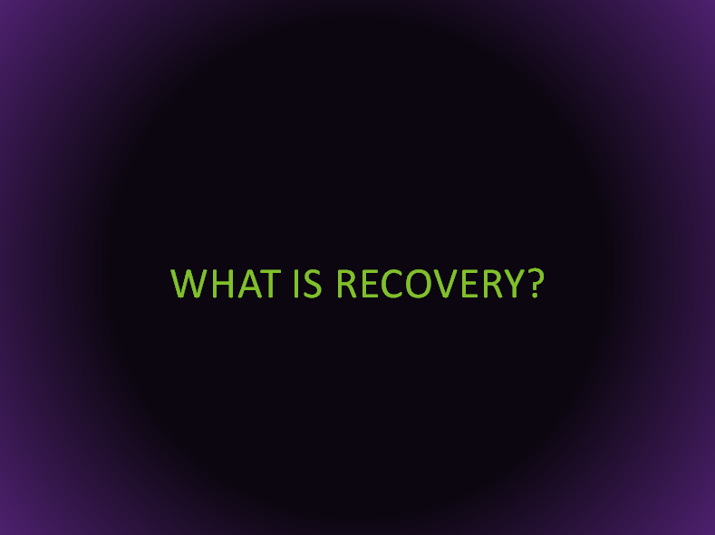
WHY USE imr?
Aims to empower clients through
  Managing their illness
  Finding their own goals for recovery
  Making informed decisions about their treatment by acquiring necessary knowledge and skills
RECOVERY

Slide 19
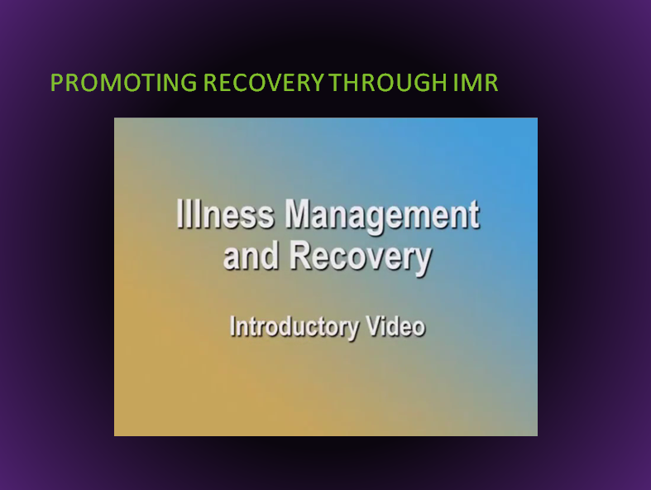
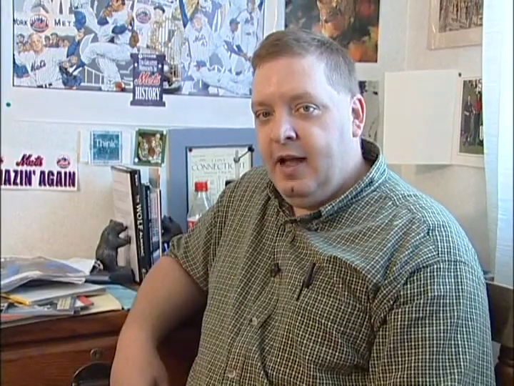
Promoting recovery through IMR

Slide 20
What is IMR?
Ten topics cover recovery strategies, substance use, medication adherence, facts about mental illness and developing supports
Six Practice Principles serve as the foundation of delivering effective IMR services
Notes:
Consider turning this slide into 10 separate slides? Each with a picture that corresponds to the topics being discussed (can include a summary of that topic or just a discussion of what that means with the audience)

Slide 21
What is IMR? The 6 practice principles
Recovery
Education
Understanding Stress
Collaboration
Relapse Prevention
Coping Strategies

Slide 22
Principle 1: Recovery
Recovery is defined by the individual
  Helping clients is the ultimate goal of IMR
  Help them identify important personal goals
  Instill hope that they can accomplish goals
  Help them identify and put into practice strategies that will facilitate progress
  Help them develop specific recovery plans

Slide 23
Principle 2: Education
Education about mental illnesses and their treatment is the foundation of informed decision making
  People are empowered by knowledge
  Answers common questions about mental illness
  How are mental illnesses diagnosed
  What are symptoms of mental illnesses
  What are the treatments of mental illness
  How common are mental illnesses
  What does this mean for me?

Slide 24
Principle 3: Stress-vulnerability model
The Stress-Vulnerability Model provides a blueprint for illness management
  IMR helps clients understands the factors that contribute to the onset and course of mental illness
  Several treatment options are available to help manage mental illness
  Stress and biological vulnerability contribute to symptoms of mental illness
  Stress and symptoms can be managed

Slide 25
Principle 4: Collaboration
Collaborating with professionals and significant others helps clients achieve recovery goals
  Many clients benefit from involving other supporters in helping take steps towards recovery
  Collaboration provides accurate information about mental illness to clarify misunderstandings
  Reduces criticism of clients who experience symptoms
  Reinforces information and skills learned in IMR sessions
  Is always the client’s choice
Notes:
Is always the client’s choice**** IS IT? Would be important to consider instances in which it is not and what the implications are

Slide 26
Principle 5: Relapse prevention
Relapse prevention and planning reduces relapses and rehospitalizations
  IMR helps clients examine their previous experience with relapse in order to develop a plan
  The Relapse Prevention Plan is a collaborative effort to identify triggers, early warning signs, and steps to take to prevent relapse

Slide 27
Principle 6: Coping strategies
Clients can learn new strategies for managing their symptoms, coping with stress, and improving the quality of their lives
  IMR affirms that clients can use cognitive-behavioral, motivational, and educational strategies to manage symptoms, stress, and relapses to significantly improve their lives

Slide 28
Four core components of imr
Psychoeducation: provides the basic information about mental illnesses and treatment options
Behavior tailoring: helps clients manage daily medication regimens by providing strategies for remembering to take medications
Relapse prevention: identify triggers of past relapses and early warning signs of an impending relapse and develop relapse prevention plans
Coping skills training: identifying clients’ current coping strategies for dealing with psychiatric symptoms and either increasing their use strategies or teaching new strategies

Slide 29

How can I possibly be effective when there is so much going on?
Time restraints
Lack of resources
Substance abuse
Cultural differences
Mental health
Trauma
Resistance
Non-compliance
Administrative Issues
Power Differential
Gang involvement
Denial
Notes:
What we’re going to talk about and practice today is using the basic MI principles in supervision to encourage supervisees to use MI in sessions, and how to keep them engage with their very challenging consumers.
What you ask of your supervisees, you must ask of yourself. How can you use MI to supervise and encourage MI?

Slide 30
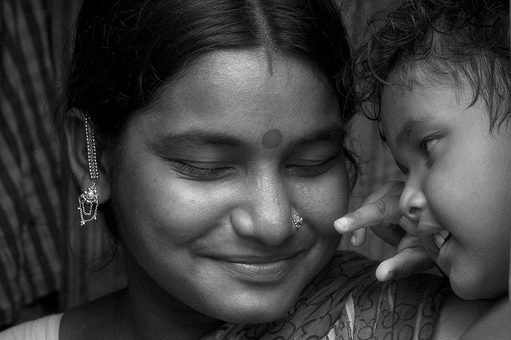

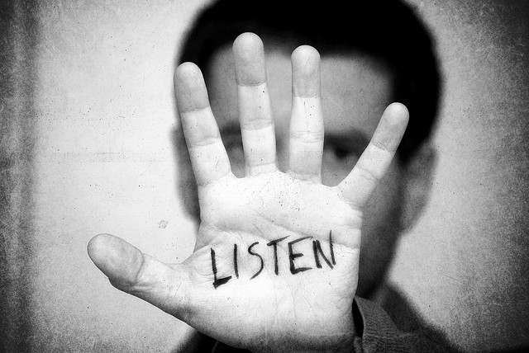
3 Keys to Success
It’s all about the relationship
Planting a seed
Learn how to listen

Slide 31
Theory X
Offenders are liars, antisocial personalities, cheat, con, and evade in order to escape the consequences of their behavior, and are unmotivated to change
Employees are ultimately lazy and unmotivated, dislike work, and will always get away with doing as little as possible
Alcoholics/addicts are deeply in denial, unmotivated to change, and will resist every effort to help them
Notes:
Douglas McGregor, through his well-known “Theory X and Theory Y,” drew a distinction between the assumptions about human motivation which underlie these two approaches, to this effect:
Theory X assumes that people dislike work and must be coerced, controlled, and directed toward organizational goals. Furthermore, most people prefer to be treated this way, so they can avoid responsibility.
Theory Y—the integration of goals—emphasizes the average person’s intrinsic interest in his work, his desire to be self-directing and to seek responsibility, and his capacity to be creative in solving business problems.

Slide 32
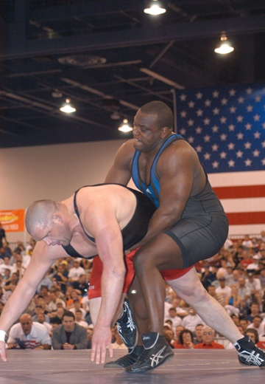
Logical Consequence of Theory X
Coerce
Correct
Control
Confront
You have to make them change by
demanding compliance

Slide 33
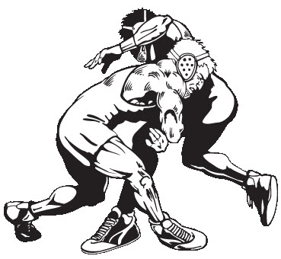
Typical Result
  Client resistance
  Defensive, frustrated & angry clients
  Evasive clients
  A wrestling match between the client and staff

Slide 34
Theory Y
Offenders have their own personal motivations for change that need to be drawn out, are resourceful, often want to change, and will make their own choices
Addicts already have their own reasons for change, often want to change, and are capable of positive choice
Workers have underutilized talents and creativity, often enjoy their work, and are capable of self-direction

Slide 35

Typical Result
Empowered
Regard themselves as capable, resourceful
Feel respected
Feel safe to explore, challenge
More likely to engage

Slide 36
The core values of IMR
Respect
Building hope
Compassion
Collaboration
Choice

Slide 37
Building hope
Predicting the future and the course of mental illness can be difficult
Those who actively participate in treatment and utilize effective coping skills have better quality of life
Clients often report that having another person believe in them is empowering and validating
IMR practitioners retain an attitude of hope and optimism, even when the client may be pessimistic

Slide 38

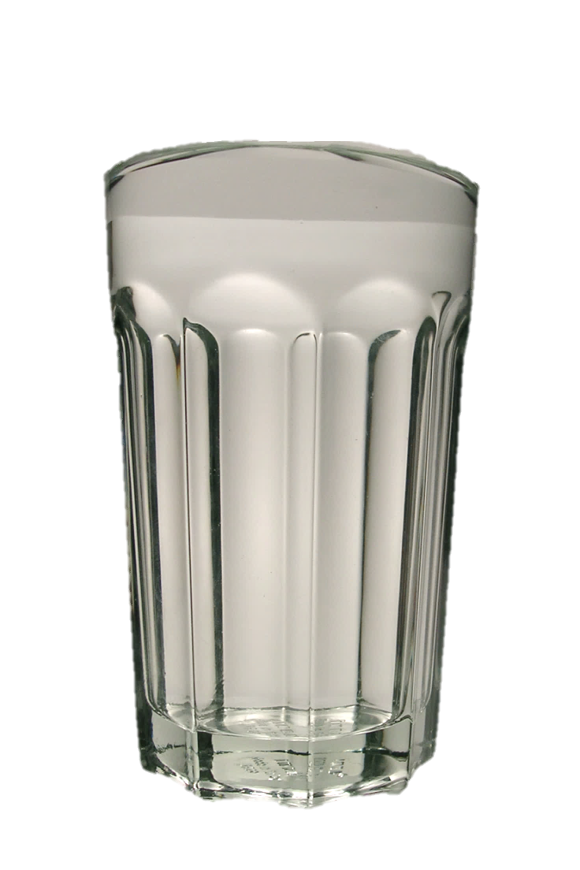
Recognize clients as experts
Clients know what has been helpful and what has not
IMR practitioners are more effective in helping clients make progress toward their personal goals if they pay close attention to consumers’ expertise
People are full glasses rather than empty glasses who need things from us.
People have expertise about themselves.
People have motivation, even if it’s hard to see.
We want to help them see what they already have in themselves.
flickr photo by by claire http://flickr.com/photos/35137234@N06/4230612281 shared under a Creative Commons (BY) license

Slide 39
Emphasize personal choice
Clients have the ability and the right to choose
The goal of IMR Practitioners is to give clients the information and skills they need to make choices about their own treatment
Responsibility for change is left with the client
Change arises from within rather than imposed from without
Emphasis on client’s personal choice for deciding future behavior
Focus on eliciting the client’s own concerns

Slide 40
Establish a collaborative relationship
Nonjudgmental and collaborative
Based on client and clinician partnership
More supportive than argumentative
Listens rather than tells
Communicates respect for and acceptance for clients and their feelings

Slide 41
Demonstrate respect
A key ingredient
Clients are fellow human beings, capable decision-makers, and active participants in treatment
May differ from your personal values
Acceptance and respect of client’s right to make informed decisions
Find common ground for a basis of collaboration

Slide 42
Finding common ground
Symptoms and distress that consumers experience
Desire to avoid hospitalization
Difficulties with independent living
A specific goal they would like to accomplish
Making the connection between their behaviors
and
something that is intrinsically valuable

Slide 43
Module 2: the core processes of IMR

Slide 44
The Core Processes of IMR
Referral to program/clinician
Introduction of IMR program
Assess the client
Determine the format of sessions
Utilize education strategies to teach clients IMR curriculum
Apply knowledge using exercises and homework
Help clients set and pursue goals
Help clients build supports
Document progress using IMR Progress Note
Meet weekly in supervision for on-going support

Slide 45
Thinking about change
Change is scary – it requires support
Change is gradual – it takes time
Developing the capacity to change – it is more important than making a single change

Slide 46
Engaging clients
Engagement starts before the client walks through your door
Engagement never stops
How do you build trust?
Notes:
Speaking about a patient in a meeting – if a case manager sees client in hallway, provide praise that was heard about in meeting (as appropriate)

Slide 47
Engaging clients
Help clients understand the structure and content of IMR, as well as their role in participating
Define common expectations for participants in IMR
Can be done in 1-3 sessions
What are the benefits of participating?
  “Are you interested in the IMR program?”
  “Which part of IMR seems most interesting to you?”
  “How do you think the IMR program can help you?”
  “If you decide to participate in IMR, what will you do?”

Slide 48
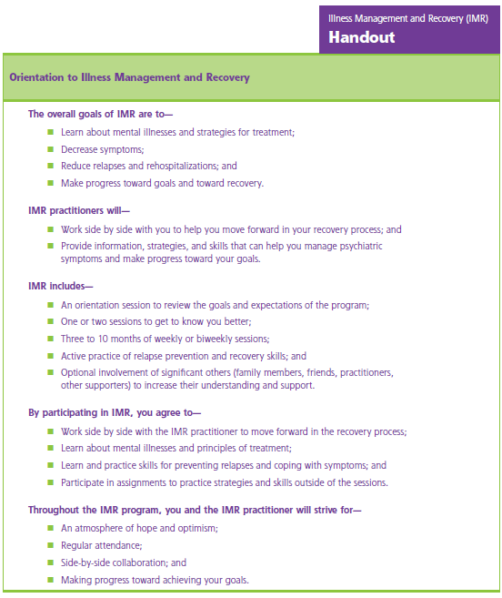
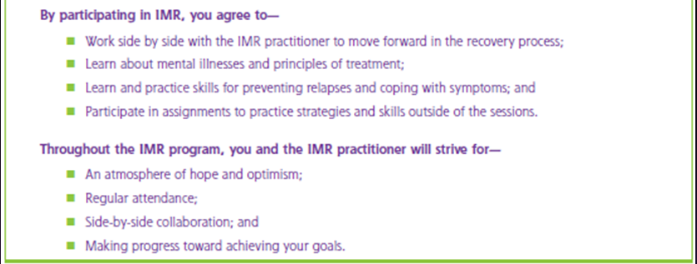

Educating clients on engaging in IMR
Notes:
Handout the brochure??

Slide 49
Assess consumers’ knowledge and skills
Assists in engagement and developing rapport
Enhances assessment and provides information to clinician
Shifts from deficit-focused to strengths-based
Be aware of tone, body language
Use feedback sandwich at end to elicit client responses about inventory

Slide 50
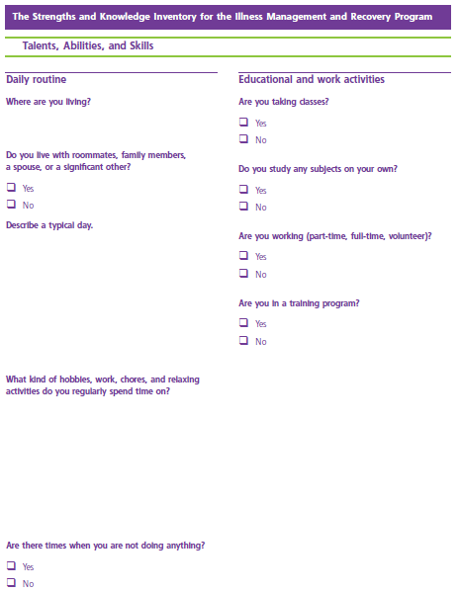
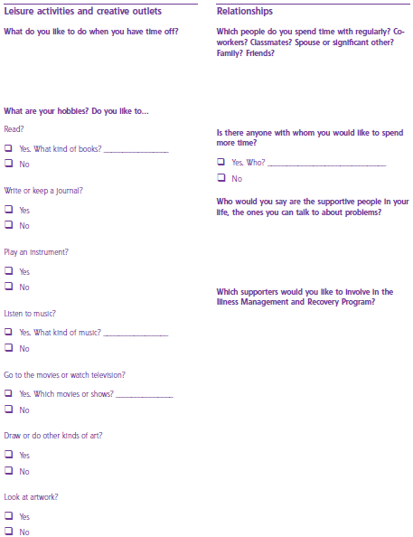

Slide 51
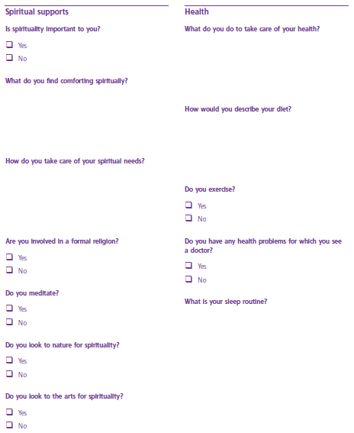
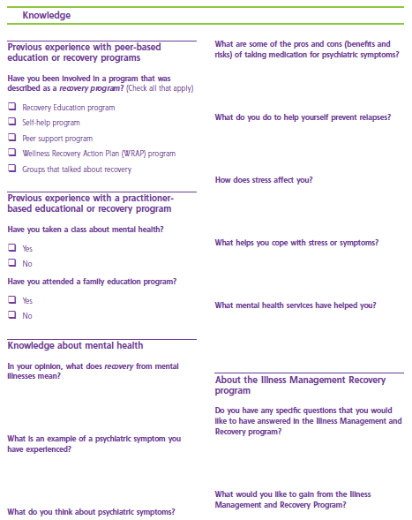

Slide 52
Following the imr curriculum
Recovery strategies
Practical facts about mental illness
Stress-Vulnerability Model and treatment strategies
Building social support
Using medication effectively
Drug and alcohol use
Reducing relapses
Coping with stress
Coping with problems and persistent symptoms
Getting your needs met by the mental health system

Slide 53
Following the imr curriculum
Recommended that initially, curriculum is administered in the order presented
As you become more comfortable, consider tailoring the program to fit individual client’s needs
Example: client reports specific symptoms that are distressing and the main focus of client’s goals
  Can utilize Topic 9: Coping with Problems and Persistent Symptoms earlier
  Use your clinical judgement to determine the order of the IMR curriculum

Slide 54
The IMR practitioner guide
Two sets of Practitioner Guides are in the booklet
  Individual format
  Group format
Each set of Practitioner Guide organizes each topic with specific recommendations for practitioner use
Multiple sessions may be needed to cover a specific topic in either format
Prior to each session, select and review the appropriate Practitioner Guide and Handouts for the topic you will be discussion

Slide 55
The imr practitioner guide
The guide gives you reminders and recommendations
such as :
Alerting you to upcoming exercises so that you may allot time to complete them
Prompt you to connect information within the Handout with consumers’ personal recovery goals
Suggest homework assignments that appropriately reinforce knowledge and skills

Slide 56
THE imR practitioner guide
Introduction
Goals for session
Handouts to be used
Number and pacing of sessions
How to structure the session
Strategies to be used in session
  Motivational, Educational, Cognitive-behavioral
  Homework
Tips for common problems
Review questions to test for understanding

Slide 57
Topic guidelines for group imr
Introduction
Goals for session
Handouts to be used
Number and pacing of sessions
How to time/structure the session

Slide 58
Session guidelines for group imr
How to begin
Session goals
Structure of the session
Motivational strategies
Educational strategies
Cognitive-behavioral strategies
Homework strategies

Slide 59
Using the handouts
Contain practical information and skills that consumers can use
Written in easy-to-understand language and include informative text
  This doesn’t mean that every client will be able to read and understand handouts – what do you do?
Handouts are interactive and not meant to be stand-alone documents
Help clients integrate the knowledge and skills presented
Handouts may differ depending on individual or group sessions
Notes:
Check frequently for understanding – this is useful in group or individual with clients (whether they have cognitive impairments or not). It is also a recommended educational strategy
Prep for groups – know the topic, have handouts prepared ahead of time

Slide 60
Using group vs individual format
Pacing and length of IMR program depends on whether format will be individual or group
Determine how your organization will place individuals into either individual or group programs and what the “cutoff” for group participation will be
Review the structure of sessions with your clients and what they should expect from you each session, as well as what you will expect from them

Slide 61
Orienting to group format
What is said in the room stays in the room between group members
Treat all group members and property with respect
Regular attendance is expected
Review all guidelines during first session
How do you deal with group members not adhering to group rules?
When should you confront group members in front of other group members?
Notes:
Only in the most extreme situations should you confront a client in front of another client

Slide 62
Pacing your session
Typically 45-90 minutes per week for 3-10 months
Length of program depends on pacing and other factors:
  Client’s prior knowledge and skill level
  Problem areas that client would like to work on
  Presence of cognitive difficulties or SMI can slow learning process
Notes:
Consider that individuals may have enough time that longer sessions are possible (depending on structure/schedule of day) – in this situation, facilitators would need to be interesting enough/have enough interesting activities to keep attention for 2+ hours.

Slide 63
Structuring your sessions
How long will your sessions be?
What materials will you need/how will they be stored?
What can you accomplish in the time you have with your clients?

Slide 64
Structuring your sessions
 | Individual Sessions | Group Sessions
Socialize informally and identify any major problems | 1-3 minutes | 1-3 minutes
Review previous sessions | 1-3 minutes | 1-3 minutes
Review homework | 3-5 minutes | 5-10 minutes
Follow up on goals | 1-3 minutes | 5-10 minutes
Set agenda for current session | 1-2 minutes | 1-2 minutes
Teach new material of review previously taught material | 30-40 minutes | 20-25 minutes
Agree on new homework assignment | 3-5 minutes | 5-10 minutes
Summarize progress made in current session | 3-5 minutes | 3-5 minutes

Slide 65
Providing homework
Reinforces information between sessions
Provides opportunities to practice skills outside of the therapeutic interaction
Involves making a specific plan for how to accomplish practice
May involve reviewing a section of the handout, finishing an exercise or actively practicing a newly acquired skill

Slide 66
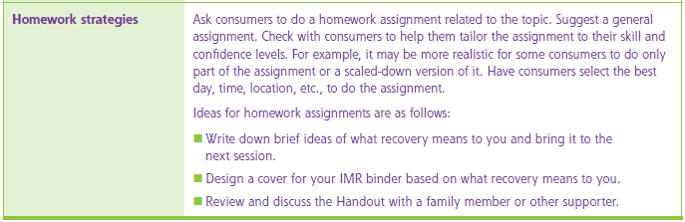
Tailor homework
1. use something from today’s session
2. take steps towards your goal
Consider two parts in developing homework:
Topic 1
Notes:
This slide corresponds to the Homework recommended for Group 1 of Topic 1 – Recovery Strategies. If individuals do not have access to write down information or design their binder or contact family during the break between the first and second session, what can you do?
Identify a way to repeat/internalize their recovery phrase
Daily schedule maintenance
Others?

Slide 67
Practice identifying and assigning homework
Pair up
One client
One counselor
Pick a homework assignment from one of the topics
Role play assigning the homework and identifying obstacles
Notes:
Consider modifying homework activities in a particular section of the workbook in order to best suit the needs of your clients

Slide 68
Resistance to homework
Don’t force clients to complete homework
Have a discussion regarding the benefits of completing homework
Identify ways homework would assist client in accomplishing their overall goals that they’ve identified
Don’t call it homework
Consider dynamics that prevent homework completion – safety, material availability, others?

Slide 69
Supporting homework
Explore their experience of trying homework
  “What were you able to do?”
  “What were you unable to do?”
  “What might you be able to do differently in the future to follow through with homework?”
Problem-solve overcoming obstacles
Collaboratively modify assignments to be more achievable
Tailor homework to the client’s needs and goals
Praise successes

Slide 70
Completing progress notes
IMR notes should be completed following every IMR session
Progress Notes help you track:
  Consumers’ personal goals
  Kinds of interventions provided
  Evidence-based skills that are taught
  Homework assigned

Slide 71
Ensuring fidelity to the imr model
Research shows a number of outcomes if the model is followed appropriately: increased knowledge about mental illness, fewer relapses, fewer hospitalizations, reduced distress, increased med compliance
QA helps to identify what is going right and areas for improvement
Frequency of data collection is ultimately determined by the program
Share results with the team in easy-to-understand summaries
Notes:
Two questions that must always be asked: has IMR been implemented the way intended; has IMR produced the results we want

Slide 72
Ensuring fidelity to imr model
Four different audit tools/assessments
Involve self-reports and interviews with stakeholders, management, staff, clients, etc.
Two completed by independent reviewer
  Illness Management and Recovery Fidelity Scale
  General Organizational Index
Two self-report questionnaires
  Consumer Outcome Survey
  Practitioner Outcome Survey

Slide 73
Ensuring fidelity to imr model
Meet with your supervisor weekly
Be an active participant in supervision
Supervision is critical in ensuring open communication among team members
Discuss client’s goals and progress being made
Consult with other IMR practitioners about difficult issues
Use information from fidelity assessments to have team discussion of ways to improve

Slide 74
Educational Strategies
Motivational Strategies
Cognitive-Behavioral Strategies

Slide 75
Educational strategies
Interactive teaching
Checking for understanding
Break down information
Review information

Slide 76
Cognitive-behavioral strategies
Reinforcement
Shaping
Modeling
Role playing
Cognitive restructuring
Relaxation training

Slide 77
Cognitive-behavioral strategies
Positive reinforcement
  Praise, smiles, interest, and enthusiasm to encourage clients to learn information and skills during and after IMR sessions
Negative reinforcement
  Help clients monitor progress in utilizing coping behaviors and relaxation techniques to experience less distress from persistent symptoms

Slide 78
Cognitive-behavioral strategies
Shaping
  Skills learned take time and practice
  Break information into small pieces
  Providing reinforcement

Slide 79
Cognitive-behavioral strategies
Modeling
  Demonstrating skills for the purpose of teaching

Slide 80
Cognitive-behavioral strategies
Role-playing
  Elicit reasons why learning skill is beneficial
  Discuss steps for applying skill
  Demonstrate skill and ask for feedback
  Engage client in role-play using same scenario
  Provide positive feedback
  Provide corrective feedback
  Engage client in another role-play
  Provide additional feedback
Notes:
Steps 4-8 can be provided by other consumers in a group format

Slide 81
Cognitive-behavioral strategies
Cognitive restructuring
  Developing an alternative, adaptive, more accurate way of looking at things
  Beliefs can be influenced by personal experience, mood, what others have told them
Notes:
Common cognitive distortions such as overgeneralizations, jumping to conclusions, “black-and-white” thinking, selective attention

Slide 82
Additional skills to utilize
Behavior tailoring
    Relapse prevention
        Coping skills training

Slide 83
Completing IMR
Client has worked through all 10 topics
Client has accomplished program goals and personal goals*
Client would benefit from on-going integration in different topic groups, booster sessions
  Consider opportunities for peer mentorship/ matching/support
Notes:
The extent to which individuals are able to accomplish goals will vary – the key will be to meet the client where they are in setting individual goals and identifying small successes in the hopes of continuing to build on accomplishments. Goal setting is covered in the upcoming Modules.
After completing the 10 topic areas, consumers may also benefit from participating in either booster sessions or support groups aimed at using and expanding skills.
Think about re-integrating individuals who have “completed” IMR but remain incarcerated or will not be released for parole for a period of time – these individuals can obtain substantial booster/practice in utilizing skills while teaching the next round of group members

Slide 84
Module 3: moving towards recovery

Slide 85
Motivational Strategies
Each IMR topic includes specific motivational enhancement strategies
How does enhancing motivation work to facilitate change?
  Reduces resistance
  Raises discrepancy
  Elicits change talk

Slide 86
Collaborate rather than confront
Client
I’ve been ordered to do DV and meth classes as well as CBT classes, and I’ve done all this stuff already. I don’t have a problem.
Counselor
It sounds like it’s a lot on your plate to take care of all at the same time. Let’s talk about what the classes are about, how you think they might be helpful, and come up with a plan that feels workable to you.
Counselor
You obviously did something to end up here and those classes didn’t work, so I’m sure you’ll figure out a way to do what you need to.
VS

Slide 87
Using motivational strategies
ENGAGING
FOCUSING
EVOKING

Slide 88
Using motivational strategies
Respect their decisions
Have them describe what is working
Ask them about their plan
Find out what’s important to them
Have them talk about their health and their goals
Ask what their goals are for treatment

Slide 89
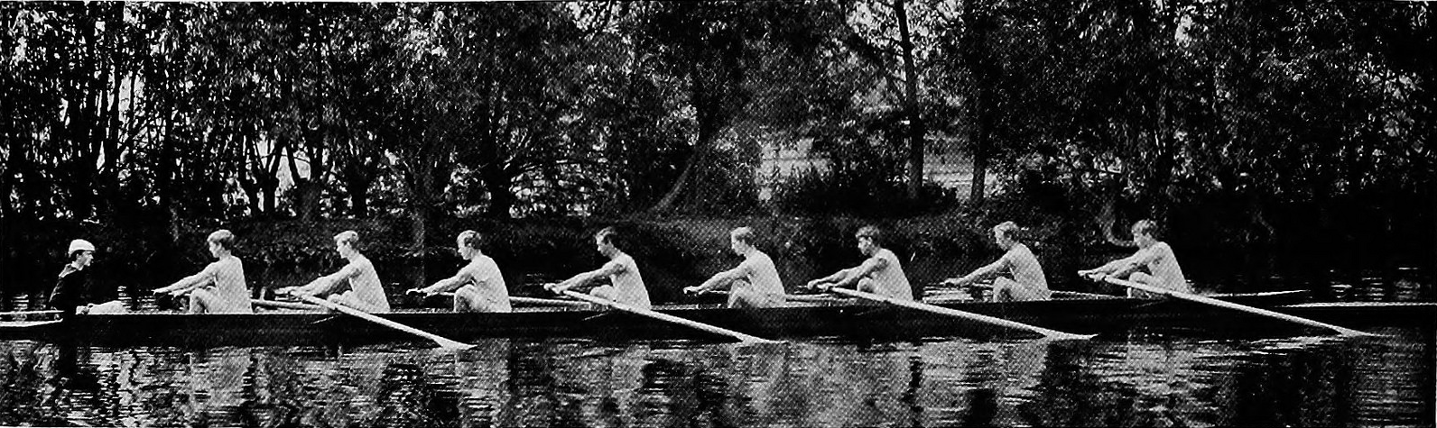
Core Skills
O pen-Ended Questions
A ffirmations
R eflective Listening
S ummarizing

Slide 90
Developing Discrepancy
Benefits
of Staying the Same
Cost
of Change
Benefits
of Change
Cost
of Staying the Same

Slide 91
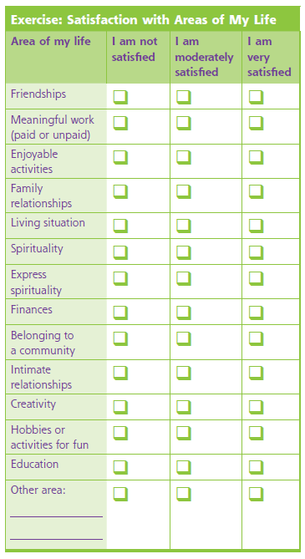
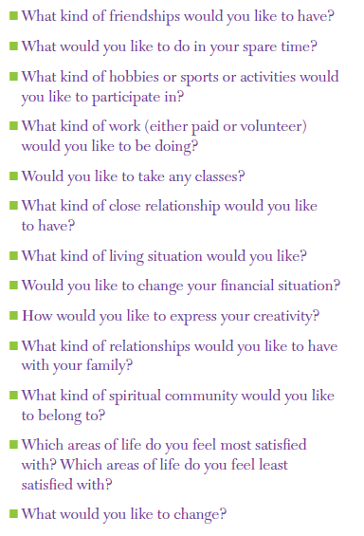

Topic 1

Slide 92
Facilitating goal setting
Guide client through identification of motivating goals and areas client might want to improve
Break goals into manageable steps

Slide 93
Facilitating goal setting
Two handouts can help clients set and pursue goals:
  Working on Goals
  Step-by-Step Problem Solving and Goal Achievement

Slide 94
Facilitating Goal Setting
Use one of the two worksheets to identify one or two goals and a few steps towards achieving them
Summarize the main points in the worksheet or ask client(s) to read them out loud
Encourage discussion of goals and client’s reactions to worksheet
Relate the material to something specific in the client’s own life

Slide 95
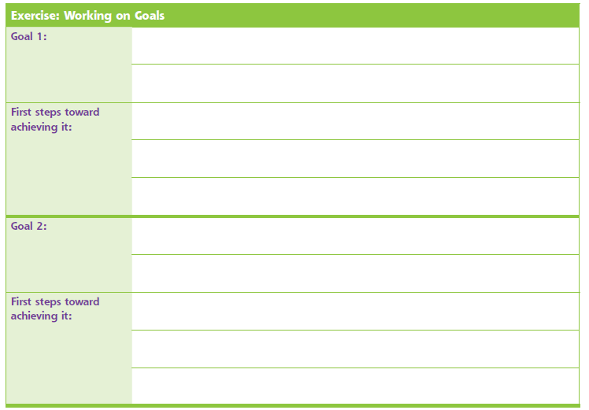
Topic 1

Slide 96
Tips for setting goals
Make them manageable
Start with short-term goals
Focus on one at a time
Keep track of progress
Get support from others
Don’t get discouraged
Keep trying – other strategies that haven’t been tried may work, just because something doesn’t work right now doesn’t mean it won’t in the future
Practice outside of session
Notes:
Praising progress, even small, is a good cognitive-behavioral and motivational strategy. Additional cognitive behavioral and motivational strategies include asking the following questions: “What is an example of a goal that you have set in the past?” (open-ended question, positive perspective) “Have you used a step-by-step plan for achieving a goal before?” (shaping)

Slide 97
challenges to goal setting
Clients may be very ambitious
Clients may find it difficult to identify goals
Ask follow-up questions to review the main points of goal setting
  What are some goals you would like to achieve?
  True or false: when people have mental illnesses, they cannot accomplish important goals in their lives
Find opportunities to praise
Reinforce goals as often as possible when discussing a new topic
Notes:
Clients may be very ambitious – goals that may take months can be broken down into smaller steps that can be achieved in a shorter amount of time
Clients may find it difficult to identify goals – get a sense of their life
Breaking down goals builds momentum and allows for smaller “building block/stepping stone” achievements
Check in about goal each session

Slide 98
The concept of recovery
Recovery, especially in the context of SMI, embraces a hopeful vision for people who experience psychiatric disorders
The ultimate goal of IMR is to support consumers’ recovery process, focusing on the concept of recovery

Slide 99
Provider role in promoting recovery
Support education for symptoms management
Encourage setting personal goals and small steps
Information, skills, support

Slide 100
Understanding mental illness
People are empowered by knowledge
The more a client understands about mental illness, the better equipped they are to speak for themselves and take an active role in treatment and recovery
Review common questions about mental illness
Create a dialogue about experiences with mental illness

Slide 101
Understanding mental illness
Which of the following is NOT a symptom of depression
  Being violent
  Feeling very sad
  Low energy level

Slide 102
Understanding mental illness
Which of the following is NOT a symptom of bipolar disorder?
  Being violent
  Feeling extremely happy or excited
  Feeling very sad

Slide 103
Understanding mental illness
Which of the following is NOT a symptom of schizophrenia?
  Being violent
  Hearing voices that other people can’t hear
  Having strong beliefs that no one else shares

Slide 104
Summarizing mental illness
What are some symptoms of ____________?
What causes ____________?
What worsens ___________?
What information would help someone who just received a diagnosis of _____________?
Who is a famous person that had ____________?
Notes:
Caution: “who is a famous person” – be careful not to adopt an attitude of “see, they did it and you can too.” This can be perceived as demeaning and not in line with a client-centered or motivational approach.

Slide 105


Mental illness is common: About 1 out of 5 people have a diagnosable mental illness
SOURCE: NIMH, 2015

Slide 106
Rates of serious mental illness are 4-6 times higher in jails and 3-4 times higher in prisons than the general population.
SOURCE: Peters, Wexler, Lurigio, 2015

Slide 107
People with mental illness can learn to manage symptoms and lead productive lives.
Yet, mental illness and many people with mental illness are highly stigmatized.

Slide 108
Counteracting stigma
Stigma occurs when someone holds a negative opinion or attitude toward people with mental illness
Stigma is a complicated problem with no easy solutions
One way to counteract stigma is to provide education and getting to know someone who has a mental illness
Stigma can create additional obstacles and stressors in the general public

Slide 109
Counteracting stigma
Become educated about mental illness, the symptoms, course of illness, and treatment options
Correct misinformation by providing information about a personal experience of living with a mental illness
Disclose information to counteract stigma selectively
Become aware of legal rights and advocacy support

Slide 110
The more you know about mental illnesses, the more you can combat prejudice, whether it comes from others or from within yourself.
Notes:
Note that self-stigma can be detrimental to the process of recovery and maintaining hope. This may arise from symptoms related to the illness, not having enough information about recognizing symptoms, and/or internalized messages about mental illness from others.

Slide 111
Recovery means more than coping
Recovery is not a cure
Recovery is not just expecting people to cope with or “deal with” mental illness
Recovery embraces a hopeful vision for people who experience mental illness; historically, not the case
The recovery framework assumes the capacity for clients to live a life in which mental illness is not a driving factor

Slide 112
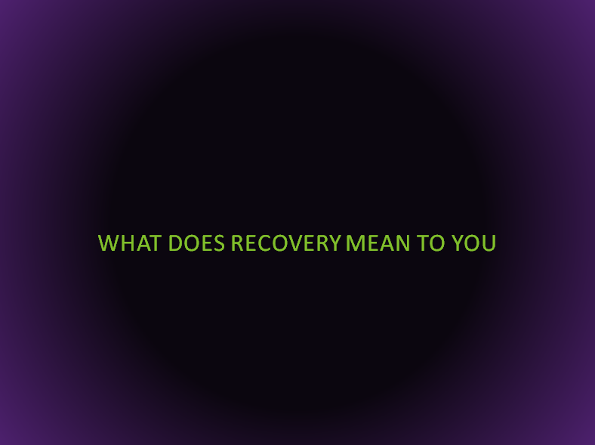
“Recovery is having confidence and self-esteem. There are things I’m good at, and I have something positive to offer the world.”
“I have goals. That’s what gives my life meaning. I’m looking to the future.”
“The most important thing in my recovery is to be as independent as possible. I’m working at that all the time.”
Get well and stay well for long periods of time
Work toward and meet personal goals
Lead happy and productive lives
“It’s about motivation.”

Slide 113
Begin the conversation about recovery
What does the word recovery mean to you?
What helps you feel confident or optimistic about the future?
What advice would you give to someone who is discouraged about recovery?

Slide 114

Recovery is a journey
COURAGE
SKILLS
KNOWLEDGE
ASPIRATION
DESPAIR
GRIEF
FRUSTRATION
LONELINESS
ANGER

Slide 115
EMPATHY IN RECOVERY
Providers should not ignore feelings or experiences as being merely symptoms of mental illness, mood swings, or labile affect
Listen and validate without discounting
Refocus on unpleasant symptoms and preventing them from recurring
Shift focus to becoming involved in something meaningful

Slide 116
Facilitating recovery-directed talk
Utilize motivational strategies to encourage discussion of strengths and goals
Help clients identify areas of satisfaction in their life to use as a foundation for further discussions of recovery
Being to develop specific strategies that might help in recovery and being to model and role-play strategies for practice
Connect discussions about strengths, goals and strategies with the Stress-Vulnerability Model

Slide 117
Recovery strategies
Become involved in self-help programs
Stay active
Develop a support system
Maintain physical health
Be aware of the environment and how it affects you
Make time for leisure and recreation
Express creativity
Express spirituality
Follow through with treatment choices

Slide 118
Module 4: learning from others

Slide 119
Learning from others
It is difficult – sometimes impossible – to make changes without some support from others
Think about a time you had to learn something new or complete a task. Who helped you? What did they do?

Slide 120
Learning from others
Recovery doesn’t mean going back to where you were before
Recovery is a continuous process of changing, growing, and learning
Other perspectives on mental illness can help clients feel connected with others who can relate to the experience and broaden their knowledge
Notes:
Distinguish between knowledge and experience here – some individuals may have difficulty giving their experience words

Slide 121
Where do we find supports?
Friends
Family
Specific support group members
Leaders of self-help programs
Spouses/significant others
Roommates
Classmates
Case managers
Staff members from housing programs or employment programs
Counselors from other programs
AA or NA groups
Spiritual group leaders or other members
Others?

Slide 122
Finding and building supports
Connect supports to goals previously discussed – how would having others who support you be helpful? What would that look like?
Identify positive relationships the client has had
Focus on building skills that will create longer-lasting relationships in the future
Evaluate the advantages/disadvantages of keeping/changing social supports

Slide 123
Defining supports
What does social support mean to you?
Who is supportive of you?
Which aspects of your relationships are you satisfied with?
What aspects of your relationships would you like to change?
In what ways are you supportive of other people?

Slide 124
Defining supports
Are you satisfied with how you are supportive of other people?
Would you like to have more social support in your life?
Which best describes how satisfied you are with your social support?
    Yes No
    Yes No
    Not satisfied A little satisfied
    Satisfied Very satisfied
    Highly satisfied

Slide 125
Develop strategies to connect
What have you done in the past to connect with others?
Increase the number of people with whom you have contact OR improve the quality of your relationships with people who you see regularly
The basics to connect:
  Find good places to meet people
  Start conversations
  Be responsive to what the other person says

Slide 126
Starting a conversation
Find someone who isn’t occupied
Choose an interesting topic. What interesting topics can you think of?
Look at the person
Demonstrate active listening skills
Ask follow-up questions and respond to their comments to let them know you’re interested in their perspective
If the person seems uninterested, try changing topics or politely ending the conversation
Avoid telling very personal things about yourself

Slide 127
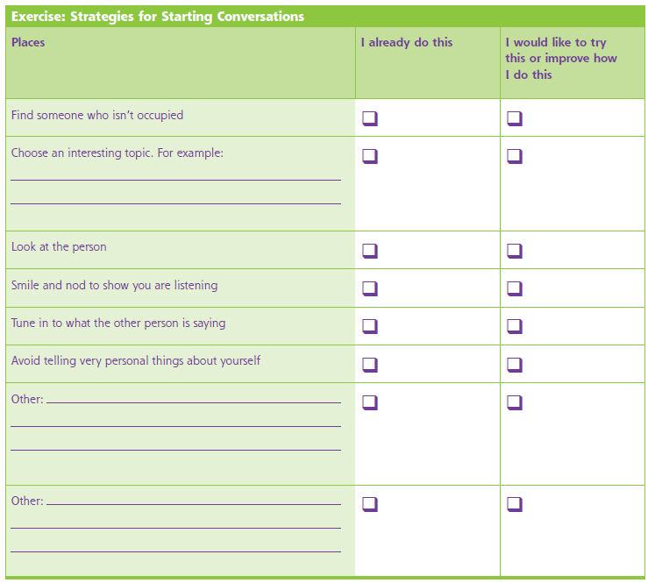
Topic 4

Slide 128


Slide 129
Overcoming obstacles
Developing insight in identifying levels of closeness
Deciding what to disclose is a personal decision
High disclosure:
telling something very
personal about yourself
Low disclosure:
telling the person something
about yourself that isn’t highly
personal

Slide 130
Navigating services
Encourage clients to be an active participant in determining which services to enroll in
Get feedback from peers who have experienced different services
Seek assistance from specific programs such as local CMHCs, research centers, consumer support agencies, or advocacy groups
Contact your local Department of Mental Health
Review and discuss the statements in the IMR handout “What types of services do Community Mental Health Centers offer?”

Slide 131
Mental health evaluation
Case management
Medication services
Peer support
Individual therapy
Group therapy
Family psychoeducation
Social skills training
Integrated COD treatment
Day treatment programs
Partial hospitalization programs
Support groups
Education about mental illness
Emergency services
Occupational therapy
Recreational therapy
Supported employment

Slide 132
Module 5: reducing biological vulnerability

Slide 133


Different types of stresses
  Positive → helping to guide growth
  Tolerable → not helpful, but not causing lasting harm
  Toxic → sufficient to overcome one’s coping mechanisms and lead to long-term impairment
+ POSITIVE
TOLERABLE
TOXIC –

Slide 134
types of stresses
Stressors
Major Negative Events | Major Positive Events | Everyday Hassles
Arrest or incarceration Major illness Hospitalization Serious injury Victimization Loss of home Divorce or separation Having a child taken away Loss of a job Family crises | New home Hospital discharge New baby Release from jail New relationship Getting married Starting a new job Promotion Pay raise Giving up addictive drugs | Deadlines Rude people Forgetting something important Traffic Cranky children Paying bills Not receiving a check on time

Slide 135
Susceptibility to stress
Increases susceptibility | Decreases susceptibility
Not feeling well Being tired Being hungry Noisy living environment Crowded living environment Social isolation Negative or pessimistic attitude Lack of meaningful stimulation | Good health Adequate rest Adequate nutrition Adequate financial resources Social support Opportunities to relax Exercise Positive or optimistic attitude

Slide 136



Psychobiological vulnerability
Genetics
Early Development
Biochemical Agents

Slide 137

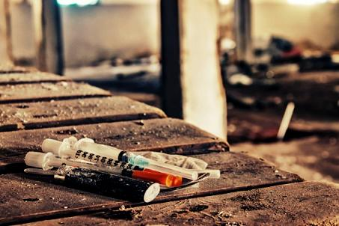
Reducing biological vulnerability
Medications
Drugs

Slide 138
Difference between
drugs and medications?
Why is this distinction important?
Substances that make people feel good but can also cause problems and make it more difficult to manage mental illness.
Medications are some of the most powerful tools available for reducing symptoms and preventing relapses.

Slide 139
Drugs vs. medications
Discussing drugs and alcohol provides foundational information on ways substance use can exacerbate mental illness
Knowledge developed can help in anticipating and addressing stressors before relapse occurs
Beliefs about the benefits of medications can vary considerably
Medications can contribute to the recovery process
Learning about medications contributes to client knowledge in order to make an informed decision

Slide 140
What does this mean for your treatment
Develop a plan that specifically focuses on on-going recovery and reducing potential for relapse
Develop new ways to get needs met
Identify pros and cons for sobriety as well as use
Identify effects of substances with clients to increase knowledge and check frequently for understanding
Encourage client to relate information to their own lives
Let them decide what is important information for them

Slide 141
How does this change treatment
Consider cognitive impairments that may have resulted from substance use/mental illness
Modify length of session – adopt the 15-15-15 method
Praise frequently
Identify and practice practical strategies for cutting down or not using
Develop a Personal Sobriety Plan
Identify potential obstacles to maintaining sobriety
Notes:
Note that praising frequently can also be an MI technique. Here, the intention is to provide specific reinforcement (consistent with MI and CBT)

Slide 142
Developing a sober lifestyle
Identify reasons for not using substances
  Better ability to manage mental illness
  Improved social relationships
  Improved ability to go to school or work
  Having your own place
  Being a better parent
  Having fewer legal problems
  Having more money to spend on other things

Slide 143
Developing a sober lifestyle
Identifying reasons
  Always ask the client’s perspective
  Connecting their reduced use to something valuable will be more motivating
Notes:
Like the ad campaign “what is your anti-drug” – but consider the “argument” against substances and how powerful the desire to use is

Slide 144
Reducing biological vulnerability
Medications
Drugs

Slide 145
Medications reduce biological vulnerability
One of the most powerful tools available to reduce or eliminate psychiatric symptoms
Confirming and enhancing knowledge of medication helps to enhance client-driven advocacy and active participation in treatment
Discuss both benefits and side effects to make informed decisions
Develop strategies to take medications regularly

Slide 146
Category | Common Meds | Uses | Side Effects | Tx for SE
Antipsychotics | Haloperidol, Risperidone, Ziprasidone, Olanzapine, Quetiapine | Designed to reduce symptoms of psychosis | Muscle stiffness, tremors, spasms, akathisia, weight gain, sexual difficulties | Reducing dose of medication; adding medication to counteract side effects; switching meds
Mood stabilizers | Lithium carbonate, carbamazepine, valproic acid | Reduce acute symptoms of extreme moods, including mania and depression | Nausea, slurred speech, extreme thirst, muscle twitching, confusion, hair loss, fever, vomiting, jaundice | Reducing dose of medication; adding medication to counteract side effects; switching meds
Antidepressants | Venlafaxine, Bupropion, Sertraline, Fluoxetine | Reduce symptoms of depression | Nausea, weight gain, heart palpitations, sedation, headache, suicidality | Reducing dose of medication; adding medication to counteract side effects; switching meds
Antianxiety/ Sedatives | Clonazepam, lorazepam, diazepam, alprazolam | Reduce symptoms of anxiety, sleep problems | Over-sedation, fatigue, problems with memory | Reducing dose of medication; adding medication to counteract side effects; switching meds
Notes:
This is not an exhaustive list; rather, note that the recommended treatment for side effects involves consulting with a doctor. If a client is requesting immediate relief, they may not be pleased to hear about the options.
Similarly, as you review this information with clients, consider what educational strategies can be used with a chart that may trigger strong feelings.

Slide 147
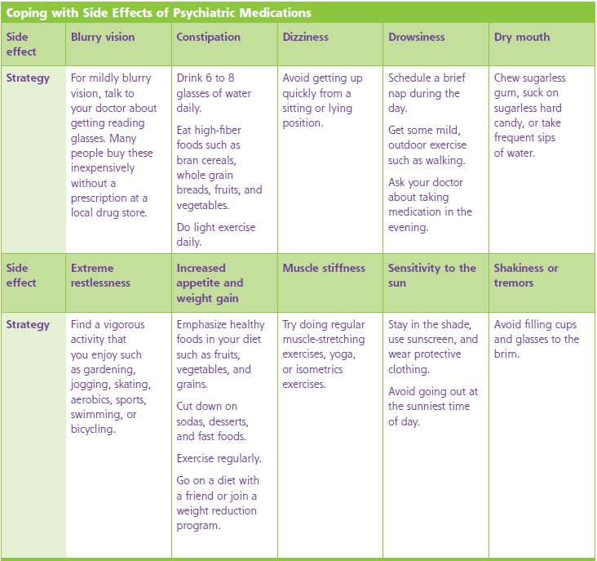
Topic 5

Slide 148

Using medication effectively is the key
effectively

Slide 149
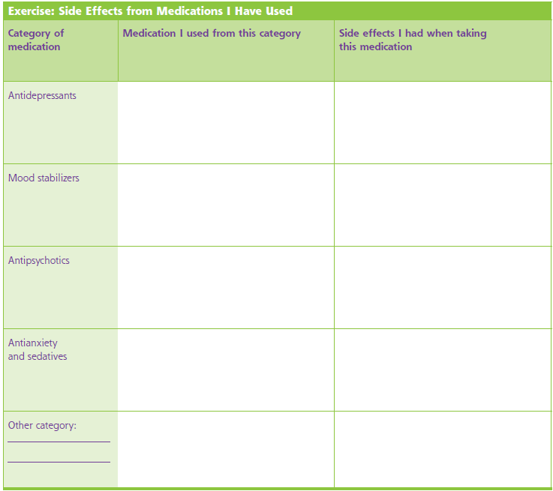
Dealing with side effects
If experiencing side effects, be sure to talk to prescribing doctor
Get as much information as possible
Consider questions to ask prior to meeting with doctor
Topic 5

Slide 150


Developing a medication schedule
Make it as simple as possible
Mon | Tues | Wed | Thurs | Fri | Sat | Sun





Slide 151
Find ways to have your needs met
Needs are the reasons people start using to start with
Finding alternative ways of getting these needs met is difficult
It can take time and effort but is critical in the recovery process
Think of someone you know who has made a commitment to recovery. How have they been able to get their needs met?

Slide 152
How life will be better by not using substances:
High-risk situations | How to deal with it
Needs | How to meet that need
Topic 6

Slide 153
Relapse Prevention Plan
Events or situations that triggered relapse in the past
Early warning signs that I experienced in the past
Things that help me when I experience an early warning sign
People who help me and what I would like them to do
People I’d like to contact in case of an emergency
Topic 7

Slide 154
Module 6: coping with stress

Slide 155
Effective stress reduction
Coping effectively can reduce the symptoms and prevent relapse
Understanding the role of stress is crucial in developing a coping plan
Two main types of stress exist:
  Life events
  Daily hassles

Slide 156
Life event stressors
Moving
Getting married
New baby
Divorce/separation
Injury
Illness
New job
Loss of job
Inheriting or winning money
Financial problems
Injury or illness of a loved one
Death of a loved one
Victim of crime
Legal problems
New boyfriend or girlfriend
Break up
Stopping smoking
Going on a diet
New responsibilities at home
New responsibilities at work
Not having a place to live
Hospitalization
Problems caused by drugs/alcohol

Slide 157
How stressed are you?
Count the number of items you checked
1 event = moderate stress
2-3 events = high stress
4 or more events = very high stress

Slide 158
Daily hassles
Not enough money for necessities
Not enough money for leisure
Crowded living situation
Crowded public transportation
Long drives/traffic backups
Feeling rushed
Involved in arguments
Doing business with unpleasant people
Noisy situation
Not enough privacy
Minor medical problems
Lack of order or cleanliness
Unpleasant chores
Dangerous neighborhood

Slide 159
How stressed are you?
Count the number of items you checked
1-2 hassles = moderate stress
3-6 hassles = high stress
7 or more hassles = very high stress

Slide 160
The impact of stress
Stress has a profound impact on physical, emotional, and psychological well-being
On-going stress has the potential to be as detrimental as a single traumatic event
Being aware of the signs of stress provides the opportunity to do something about it
It is easy to dismiss signs of stress

Slide 161
Developing an individual coping plan
Stressful Situation
Signs that I am under stress
Strategies for preventing stress
Strategies for coping with stress
Topic 8

Slide 162
Additional types of coping techniques
Deep breathing
Progressive muscle relaxation
Mindfulness
Topic 8
Notes:
Deep breathing: Choose word that you associate with relaxation such as CALM, RELAX, or PEACEFUL
Inhale through your nose and exhale slowly through your mouth. Take normal breaths, not deep ones
While you exhale, say the relaxing word you have chosen. Say it very slowly, like this: “CAAAAAAAAAAAAAAALM” or “REEEEELAAAAAAX”
Pause after exhaling before you take your next breath. If it’s not too distracting, count to four before inhaling each new breath
Repeat 10-15 times
Progressive muscle relaxation:
Neck rolls – drop your head to one side, gently roll it around in a wide circle. Repeat 3-5 times. Reverse and repeat.
Shoulder shrugs – life both shoulders in a shrugging motion. Try to touch your ears with your shoulders. Let your shoulders drop down after each shrug. Repeat 3-5 times.
Knee raises – reach down and grab your right knee with one or both hands. Pull your knee up toward your chest as close as comfortably possible. Hold your knee there for a few seconds before returning your foot to the floor. Repeat for left leg. Repeat entire sequence 3-5 times.
Mindfulness:
Imagining a peaceful scene: choose a scene that you find peaceful, calm, and restful. Imagine as many details as possible. What do you see? What do you hear? What do you feel? What smells are present? Disregard any stressful thoughts and keep your attention on the peaceful scene. Allow at least 5 minutes for technique.

Slide 163
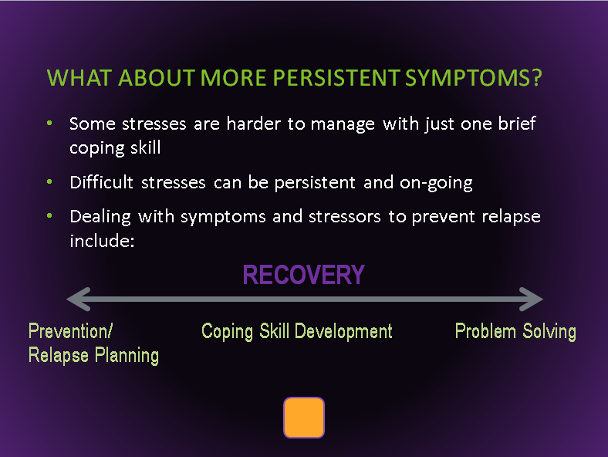
What about more persistent symptoms?
∞
Some stresses are harder to manage with just one brief coping skill
Difficult stresses can be persistent and on-going
Dealing with symptoms and stressors to prevent relapse include:
RECOVERY
Prevention/ Coping Skill Development Problem Solving
Relapse Planning
Prevention/
Relapse Planning
Coping Skill Development
Problem Solving

Slide 164
Developing effective problem solving
Keep clients engaged and identify coping skills that are specific to problems identified by the client
Help clients identify problems and reframe problems as goals
Ensure understanding of topics using handouts prior to developing plan
Provide affirmations and encouragement throughout process
Encourage and assist in identifying small “first steps”
Encourage use of supports if available

Slide 165
Each group will be assigned one topic from the IMR handbook
With your client(s), go through the session, following the IMR recommended outline for a session
  Welcome the group and identify major problems
  Review previous session
  Review homework
  Follow-up on goals
  Set agenda for current session
  Teach new material/review handouts
  Agree on homework assignment
  Summarize progress made
Notes:
For “review homework” in this exercise, the client will use the homework assignment discussed on Day 1 training Module 2.
Do not follow recommended time limits during the exercise (too long).

Slide 166
Remember!
Educational Strategies
Motivational Strategies
Cognitive-Behavioral Strategies

Slide 167
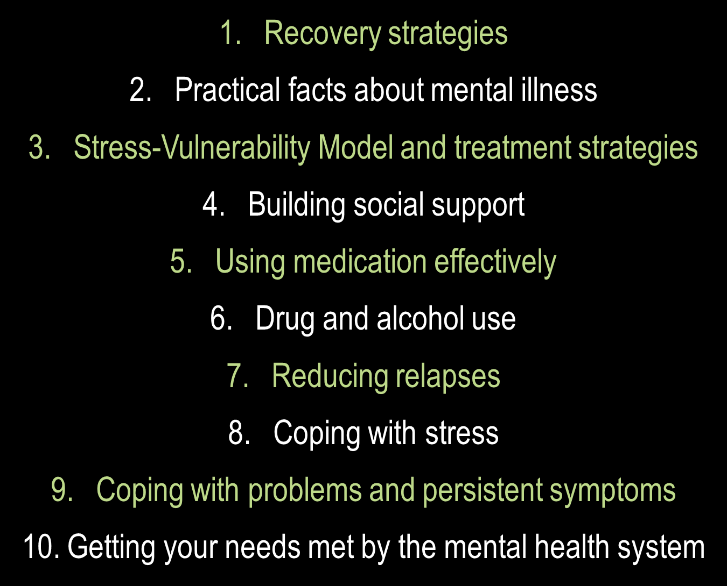
Recovery strategies
Practical facts about mental illness
Stress-Vulnerability Model and treatment strategies
Building social support
Using medication effectively
Drug and alcohol use
Reducing relapses
Coping with stress
Coping with problems and persistent symptoms
Getting your needs met by the mental health system
Module 1:
Basic Elements and Core Values
Module 2:
Core Processes
Module 3:
Recovery and the Stress-Vulnerability Model
Module 4:
Motivational, Educational, and Cognitive-Behavioral Strategies
Coping with Stress
Reducing Biological Vulnerability
Day 3: Insight and Coping Skill Development
Learning From Others
Moving Towards Recovery
Day 2: Motivation and Supports
The Core Processes of IMR
The Basic Elements of IMR
Day 1: Introduction
Notes:
Day 1: Topic 1
Day 2: Topic 2, 4, 10
Day 3: Topic 3, 5, 6, 7, 8, 9

Slide 168
Implementation Barriers and Facilitators
Research on how best to effectively implement is limited
One study at 12 community mental health clinics found broad themes emerging related to effective implementation
Implementation is facilitated by strong leadership
Organizational culture that embraces innovation
Effective training must be offered
Committed staff assists in the implementation process
Organizations where one or more of these factors are lacking may need to consider alternative strategies for implementation and sustainability
SOURCE: Whitley et al, 2009

Slide 169
Additional Lessons Learned
(Up to this point)
Continuing to practice is essential
Messaging/buy-in are key and don’t just happen at one time
Developing proficiency with the manual takes time
Deeper clinical conceptualization, less difficulty managing administrative challenges develops around 6 months
Modification of activities can be difficult
Process vs skill development
Attrition plays a significant role

Slide 170
Thank You!!
Andrew Kurtz, MFT
ASKurtz@mednet.ucla.edu
www.psattc.org
www.motivationalinterviewing.org
UCLA

